Slide 1
Ash Seed Collection
Is the seed ready for collection? & Watching out for insect damage

Slide 2
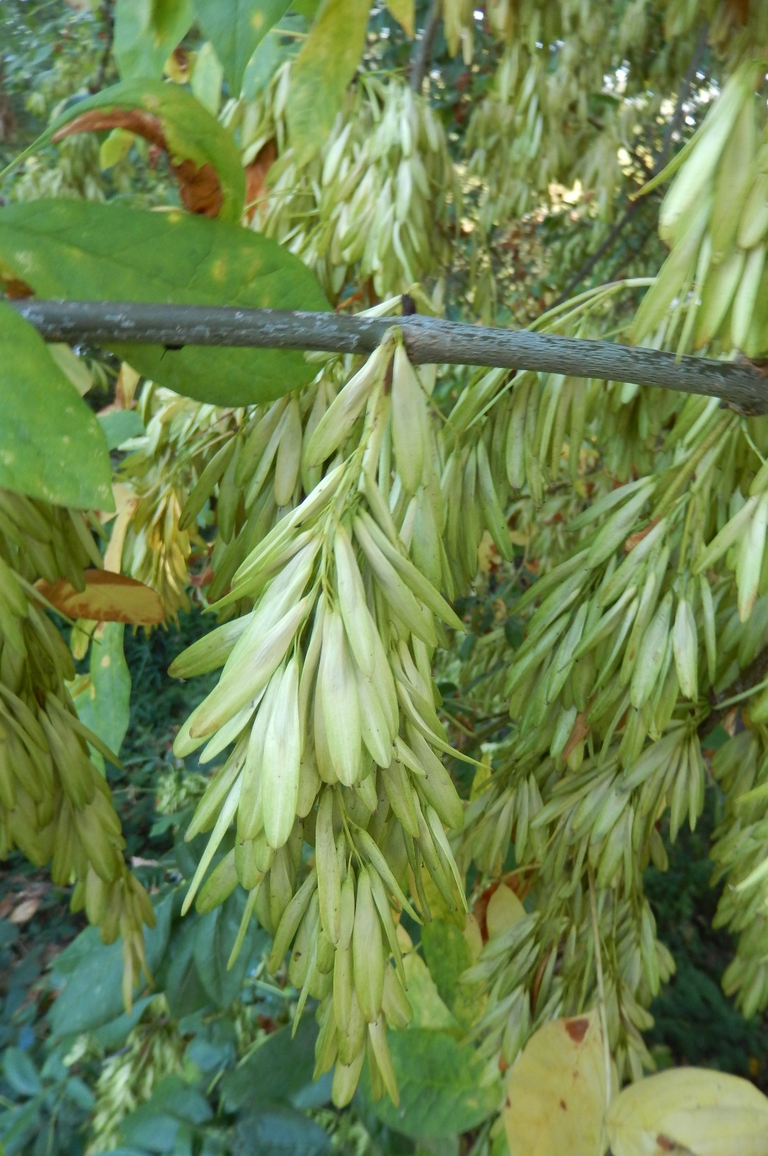
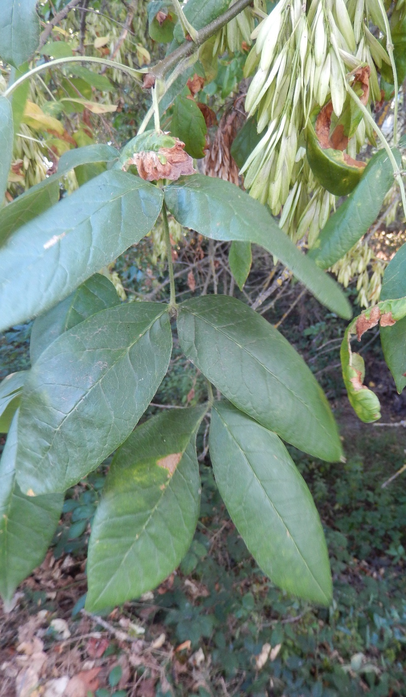
Oregon ash seed –
Eugene, OR, late Aug 2019
(photos: R.Sniezko)
Some trees can have 1000’s of samara (seed)

Slide 3
When and What to Collect?
Seeds are expected to ripen (and start falling from tree) late August-Oct
Dissection to observe embryo development, weevil damage. (See pictures below.) Cut lengthwise using razor blade. Observe with hand lens.
Don’t collect if <50% of the seeds don’t look good. Some seeds will be damaged by seed weevils and/or have unviable embryos. That is OK and expected.
Color change. Don’t wait too long but realize that samaras are shed early if empty (no seed) or if seeds are damaged (weevils).
Best time is when peduncles start to yellow or transition from yellow to brown (Carstens)
Collection summary from ODF Oregon Ash Seed Collecting Protocol;
PC: 427362-18; PCA: 51047 Index:27400

Slide 4
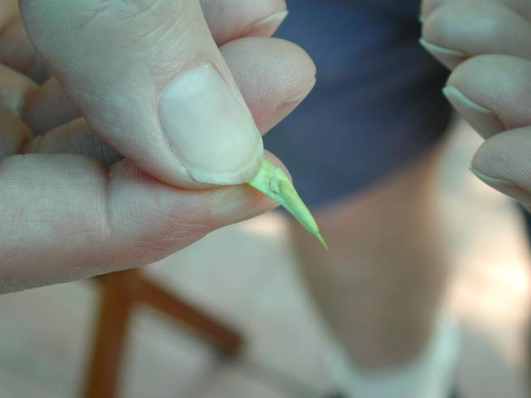
To examine the seed, first grasp it as shown here. The fruit can then be torn open with the thumb nail of the other hand to expose the developing seed.
Slide by R.P. Karrfalt - Director, USFS National Seed Laboratory

Slide 5
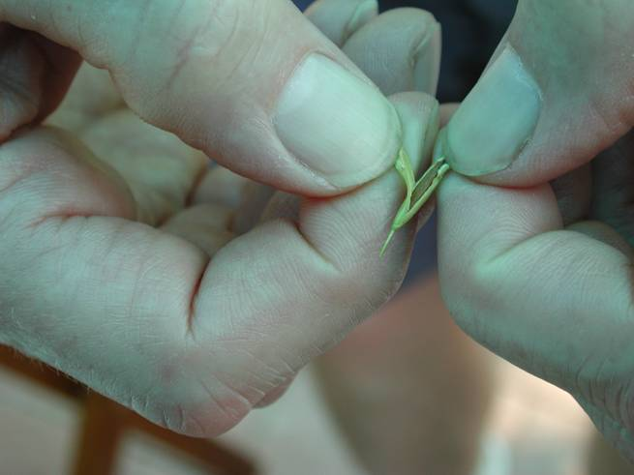
This fruit has been torn open to expose the seed for examination.
Slide by R.P. Karrfalt - Director, USFS National Seed Laboratory

Slide 6
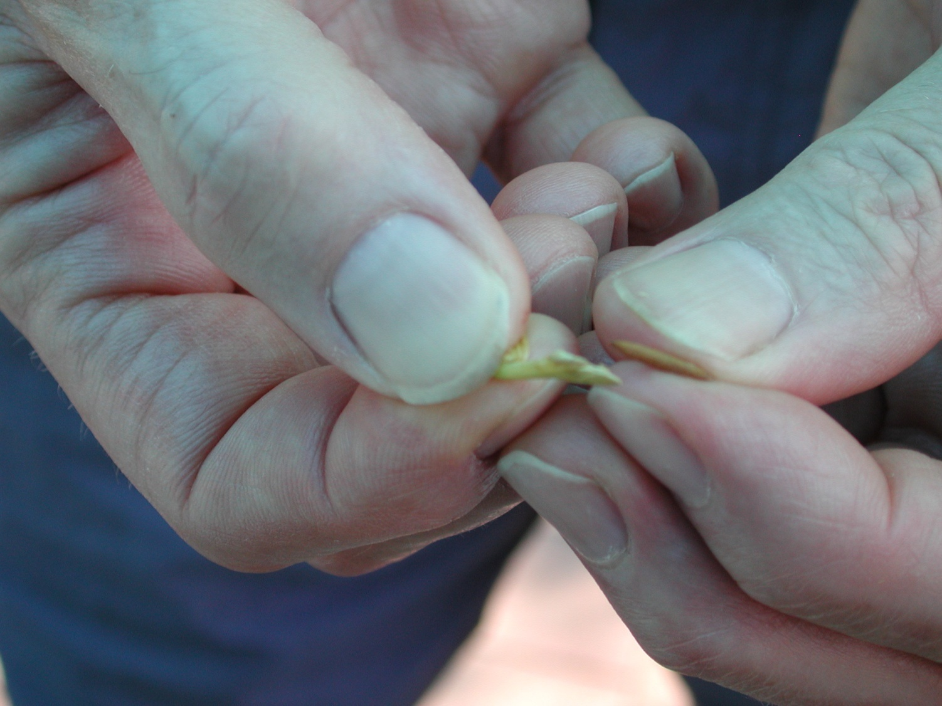
seed
Fruit torn open
This seed has been pulled from the fruit after tearing the fruit open. The brown seed color indicates the fruit is ready for harvest.
Slide by R.P. Karrfalt - Director, USFS National Seed Laboratory

Slide 7
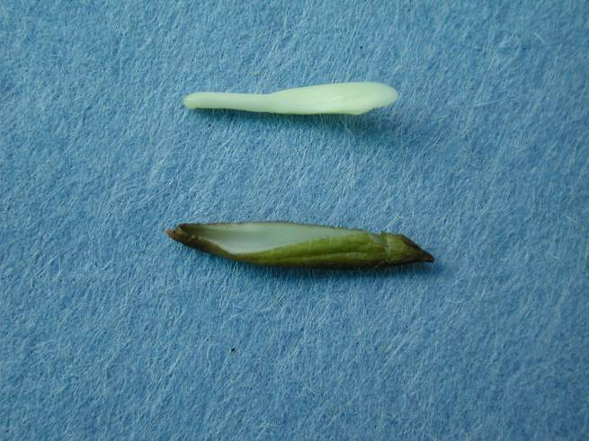
A green immature seed excised from the fruit with the embryo excised from the seed. The embryo is firming up but is still immature.
Radicle (seed root)
Cotyledons (seed leaves)
Immature seed (embryo removed)
Slide by R.P. Karrfalt - Director, USFS National Seed Laboratory

Slide 8
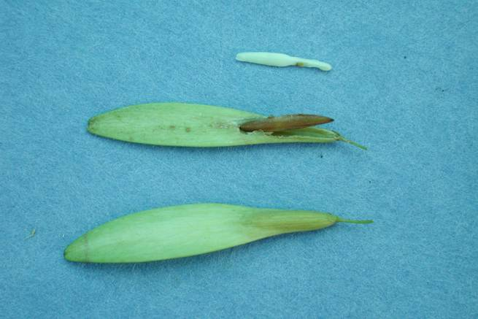
Cotyledons (seed leaves)
Radicle (seed root)
A firm full sized embryo
Fruit torn open exposing seed
Whole fruit
White ash seeds at different stages of examination. These seeds are ready to collect because the seed coat is brown, the seed fills the fruit, and the embryo and endosperm are firm and not soft or milky.
Slide by R.P. Karrfalt - Director, USFS National Seed Laboratory

Slide 9
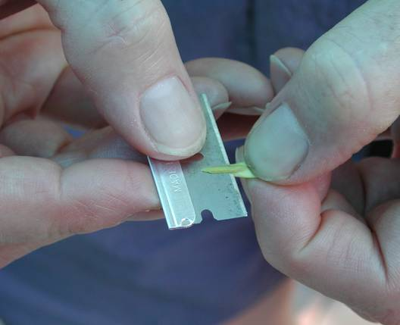
Fruits can also be cut longitudinally with a razor blade to make a clean cut that sometimes makes it easier to see more detail.
Slide by R.P. Karrfalt - Director, USFS National Seed Laboratory

Slide 10
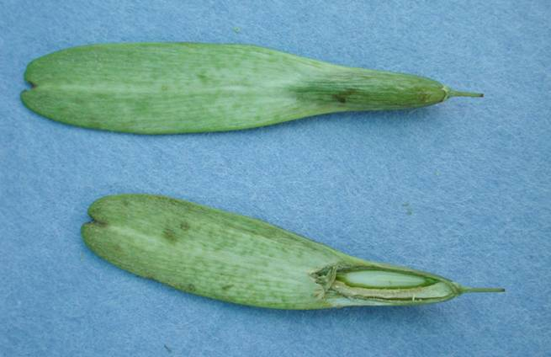
Whole uncut white ash fruit
Immature seed
Fruit cut longitudinally
Placental tissue
Longitudinal cut showing the developing seed. This seed is about half of its mature size. It is important to distinguish between the seed and the placental tissue next to it. Otherwise it could be concluded that the seed fills the fruit when in fact it only about half fills the fruit with the other half filled with placental tissue. This seed is not mature enough to harvest. The seed must develop further.
Slide by R.P. Karrfalt - Director, USFS National Seed Laboratory

Slide 11
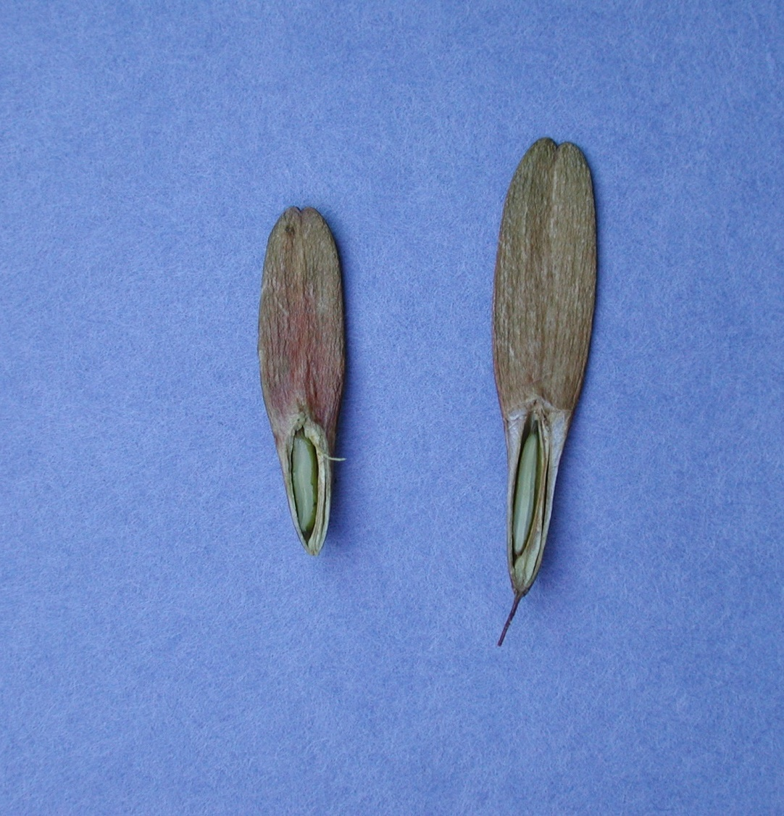
Longitudinal cut showing the developing seed. This seed is almost mature size, but is not mature enough to harvest. The seed coat is still green in color. Seeds from their mother tree must develop further before picking.
Developing seed
Placental tissue
Slide by R.P. Karrfalt - Director, USFS National Seed Laboratory

Slide 12
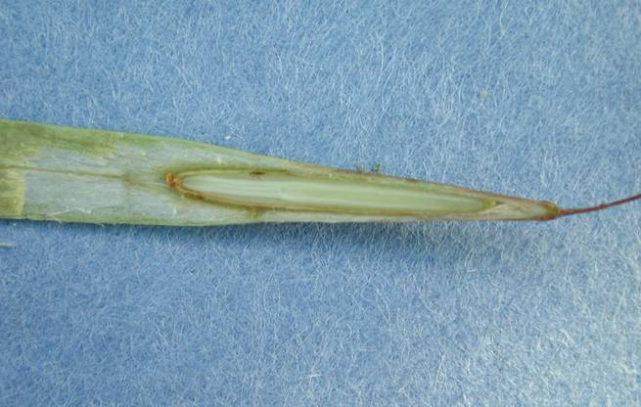
Radicle (seed root)
Cotyledons (seed leaves)
This longitudinal cut of a green ash seed shows that the seed fills the fruit cavity and the embryo has reached full length. It is ready for harvest.
Slide by R.P. Karrfalt - Director, USFS National Seed Laboratory

Slide 13
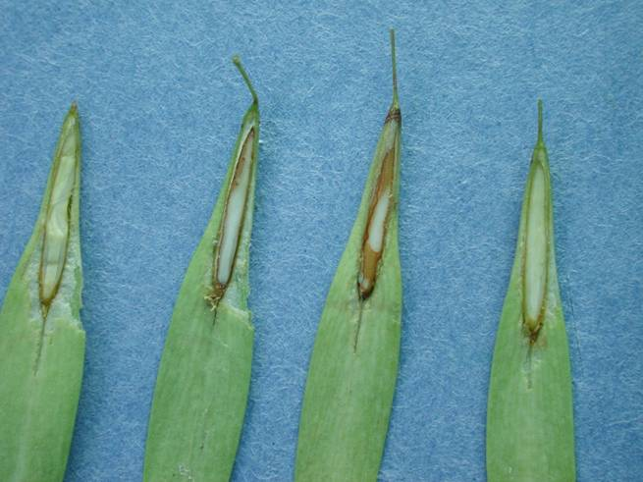
Tan seed coats
Longitudinal cuts on green ash seeds showing that the seed coats have matured and turned tan colored. These seeds are ready for harvest.
Slide by R.P. Karrfalt - Director, USFS National Seed Laboratory

Slide 14
Watching out for insect damage
When insects feed on seeds the seeds are often killed.
A longitudinal cut with a razor blade or knife will show if the seed is damaged.
Insect damage can also be seen in an x-ray
Weevils and seed bugs cause damage to ash seeds.
Slide by R.P. Karrfalt - Director, USFS National Seed Laboratory

Slide 15
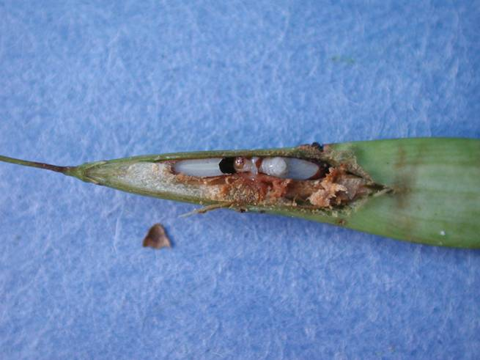
A weevil larva has destroyed this seed.
Larva
Head of larva
Slide by R.P. Karrfalt - Director, USFS National Seed Laboratory

Slide 16
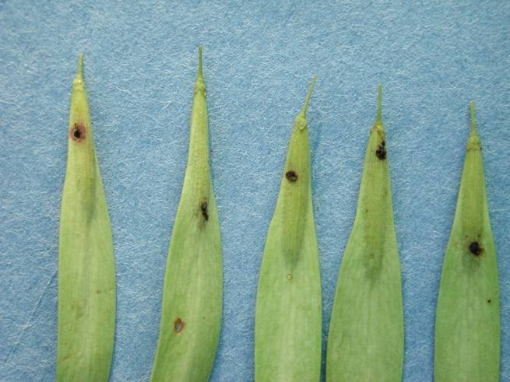
Possible seed bug wounds
These fruits apparently have been attacked by a seed bug.
Slide by R.P. Karrfalt - Director, USFS National Seed Laboratory

Slide 17
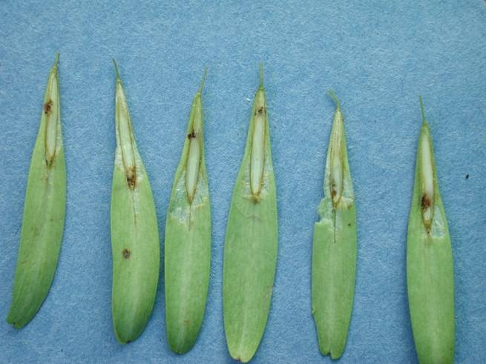
Longitudinal cuts showing the seeds in the previous slide have been damaged at the same point as the fruit was damaged.
Do not collect from trees with heavy amounts of insect damaged seeds. These seeds are of poor quality and not likely to germinate.
Possible seed bug damage
Slide by R.P. Karrfalt - Director, USFS National Seed Laboratory

Slide 18
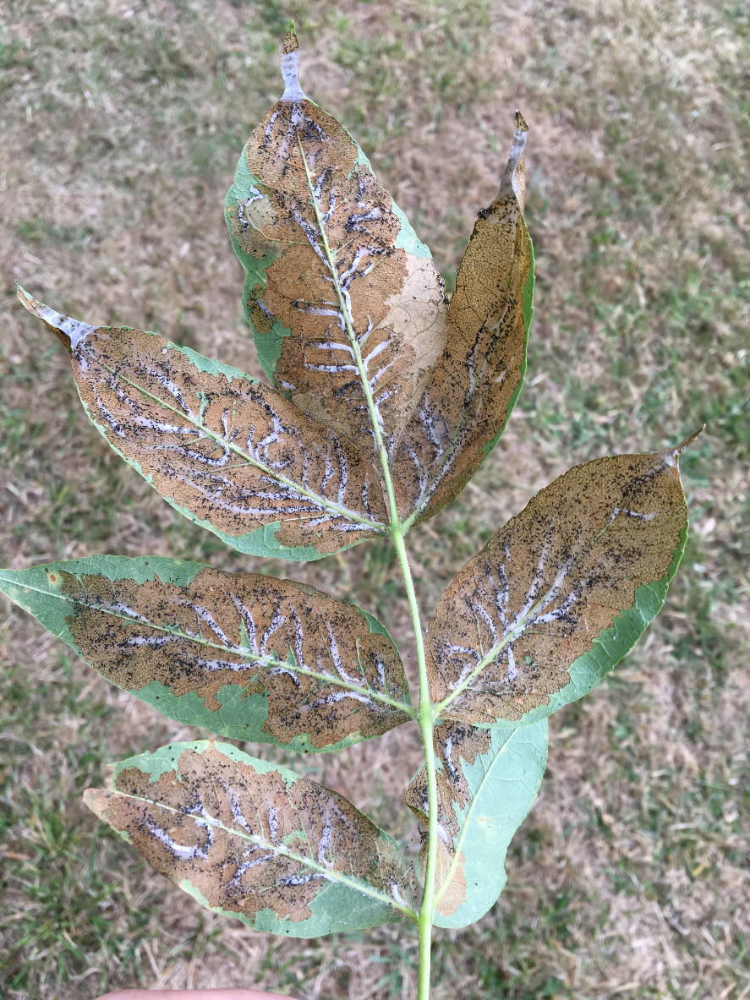
(photos by Norma Kline)
OREGON Ash leaf ‘skeletonizer’
If you see these symptoms on ash trees in your area please record location, take photo and report findings to Megan Lewien (megan.lewien@usda.gov or Richard Sniezko (richard.sniezko@usda.gov)

